Slide 1

Natural Gas Prices vs. Employment Data Exploration and Analysis
Matt Burns
DSC 530
Bellevue University
6/1/2019

Slide 2
Project analysis slide 3
Contents
HYPOTHESES
VARIABLES
HISTOGRAMS
PMFs and CDFs
CORRELATION
TEST and REGRESSION
This section details the hypothesis regarding a potential relationship between natural gas prices and mining employment.
This section describes the employment and natural gas price data sets. It explains why a specific natural gas price was used in favor of another.
This section includes histograms of the variable and illustrates the lack of concern regarding outliers.
Supplemental descriptive characteristics include:
Mean
Mode
Std. Dev.
The section illustrates the variance of gas prices in different years with a Probability Mass Function.
A Cumulative Distribution Function of gas prices to its percentile.
Analytical distribution natural gas prices.
Scatter plots compare the relationship between natural gas prices and total employment and mining employment.
Two regressions are attempted to expkain employment with respect to natural gas prices.
Pearson’s correlation is also calculated.

Slide 3
Project analysis slide 6
Hypothesis
Fact 1) Coal mining jobs were slow to recover after the Great Recession.
Fact 2) Fracking drove natural gas prices lower during this same period.
Fact 3) Natural Gas and Coal are substitute products as they both are used in electricity generation.
Hypothesis) Lower natural gas prices decreased demand for coal and diminished mining employment.

Slide 4
Project analysis slide 8
Candidate Variables
GAS PRICES
EMPLOYMENT
2 VARIABLES
VARIABLES
Industrial Natural Gas Price reflects the wholesale price of Natural Gas. (It’s called ng_price_ind in the dataset)
Residential Natural Gas Price reflects the retail price of Natural Gas. (It’s called ng_price_res in the dataset)
Private reflects the employment at private firms.
Nonfarm is considered total employment for this report.
Goods reflects the employment in mining, manufacturing and construction.
Service reflects the employment in the service industry.
Mining and logging will act as a proxy for coal mining employment in this study.
Leisure & Hospitality reflects includes the tourism industry.
Manufacturing represents the creation of products.
Government employment includes federal, state and local.
Retail includes food, gas and consumer staples.
Transportation and utility includes warehousing and passenger transportation.
120 OBESERVATIONS
Monthly data from January, 2009 to December, 2018.
Monthly is the native frequency and no points are missing.
SOURCE
120 OBESERVATIONS
U.S. Energy Information Administration (EIA)
Monthly data from January, 2009 to December, 2018.
Monthly is the native frequency and no points are missing.
SOURCE
Bureau of Labor Statistics

Slide 5
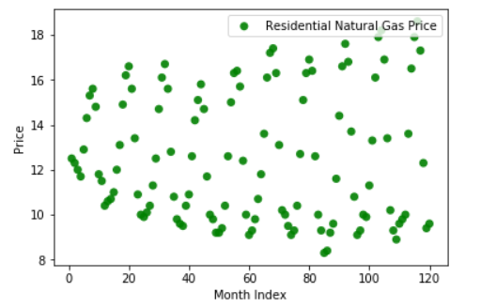
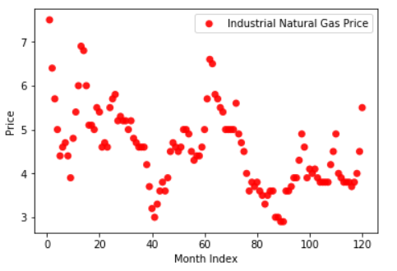
Project analysis slide 8
Which Natural Gas Price?
RESIDENTIAL
INDUSTRIAL
Rejected: Too much seasonality.
Utilized for project.
Final scrubbed data available at: https://github.com/mattburns963/530

Slide 6
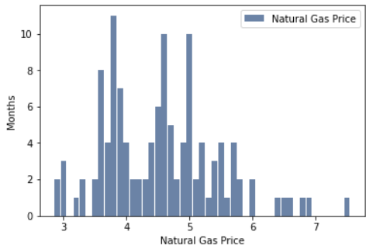
Project analysis slide 5
Natural Gas Price Histogram
Mean
Mode
Standard Deviation
4.55
3.7
0.90

Slide 7
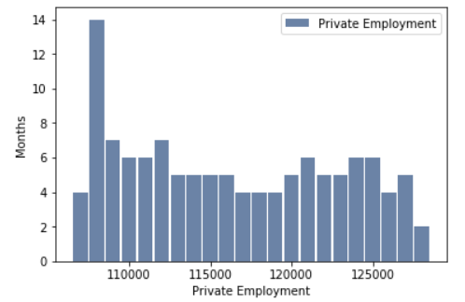
Project analysis slide 5
Private Employment Histogram
Mean
Mode
Standard Deviation
116,309
108,000
6,440

Slide 8
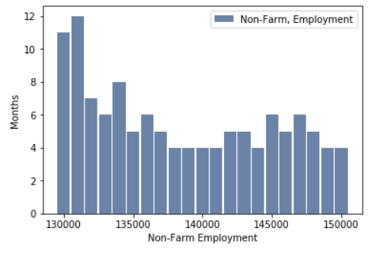
Project analysis slide 5
Non-Farm Employment Histogram
Mean
Mode
Standard Deviation
138,439
131,000
6,454

Slide 9
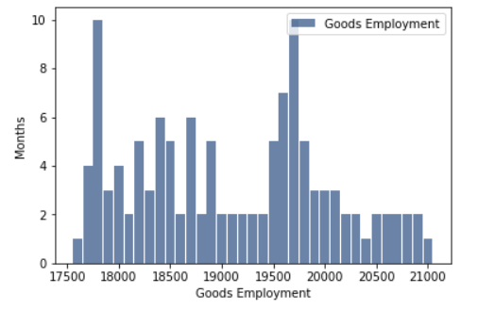
Project analysis slide 5
Goods Employment Histogram
Mean
Mode
Standard Deviation
19,088
17,800
932

Slide 10
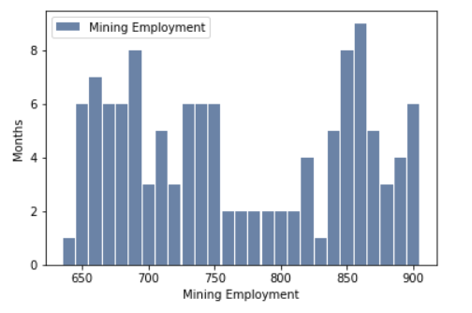
Project analysis slide 5
Mining Employment Histogram
Mean
Mode
Standard Deviation
767
860
82

Slide 11
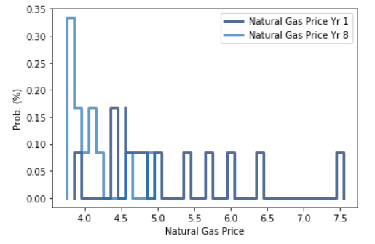
Project analysis slide 10
Natural Gas Price
Probability Mass Function
This illustration compares 2009 to 2017.
We can see that Natural Gas is cheaper in 2017, but I don’t like PMFs for monthly data.
A good old fashioned line graph would be more informative.

Slide 12
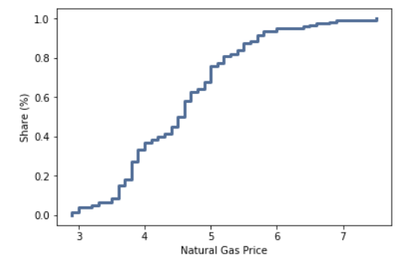
Project analysis slide 10
Natural Gas Price
Cumulative Distribution Function
This graph illustrates that very few months have a gas price over 6 or less than 3.5. It is illustrating the tails.

Slide 13
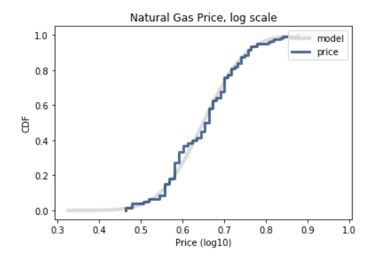
Project analysis slide 10
Natural Gas Price
Lognormal Distribution
The lognormal Distribution fits nicely with the actual data.
That means that the logs of the natural gas prices have a normal distribution.

Slide 14
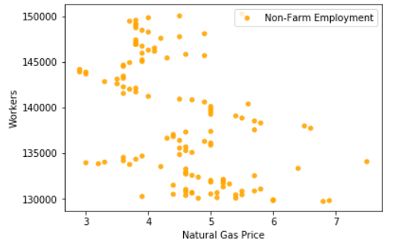
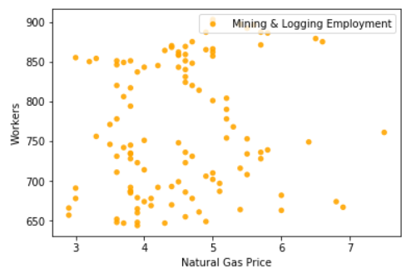
Project analysis slide 10
Scatter Plots
These graphs illustrate the relationship between two types of employment and Natural Gas Prices.
Left is total employment vs. Natural Gas Prices.
Right is sector employment vs. Natural Gas prices.
There’s nothing going on here regarding correlation!

Slide 15
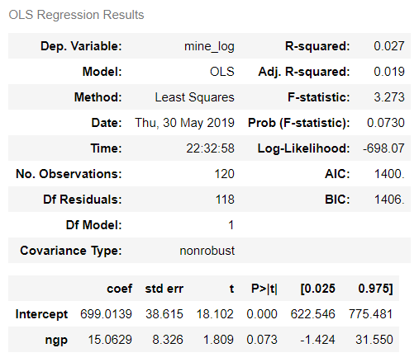
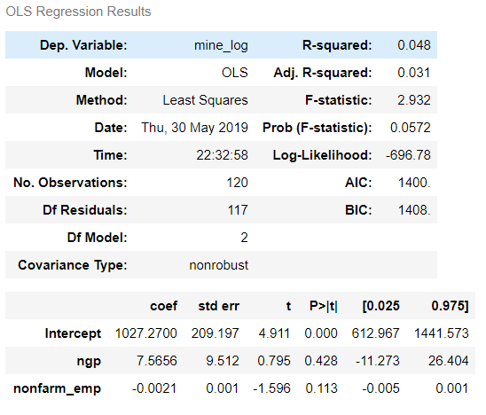
Project analysis slide 8
Regressions
GAS PRICE vs MINING EMPLOYMENT
GAS PRICE vs MINING EMPLOYMENT
(CONTROLLING FOR TOTAL EMPLOYMENT)
120 OBESERVATIONS
These regressions failed to explain mining employment as a result of Natural Gas Prices.
Also, Pearson's correlation to test had a p-value > 5%.

Slide 16
Thank You to 24 Slides for this template https://24slides.com

